Slide 1

UNIVERSITY INSTITUTE OF SCIENCES
Academic Unit V
Bachelor of Engineering
(Computer Science & Engineering)
Biology For Engineers 23SZT148
Smart Medical Instrumentation Systems
DISCOVER . LEARN . EMPOWER

Slide 2
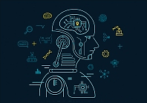
Course Outcome
CO Number | Title | Level
CO1 | Identify the biological concepts from an engineering perspective. | knowledge
CO2 | Development of artificial systems mimicking human action. | Understand
CO3 | Explain the basic of genetics that helps to identify and formulate problems | Analyze
CO4 | Apply knowledge of measurement system, biomedical recording system and biosensors to excel in areas such as entrepreneurship, medicine, government, and education. | Apply
CO5 | Integrate biological principles for developing next generation technologies, | Create
Will be covered in this lecture
https://images.app.goo.gl/5obqqxo93P2UBmdU6

Slide 3

SYLLABUS
Unit-2 | Biosensors and measurement system | Contact Hours: 15
Chapter 1 Medical Instrumentation Chapter 2 Measurement System Chapter 3 Biological Sensor | Medical Instrumentation: Sources of biomedical Signals, Basic medical Instrumentation system, Performance requirements of medical Instrumentation System, Microprocessors in Medical instruments, PC base medical Instruments, General constraints in the design of medical Instrumentation system, Regulation of Medical Devices. Measurement System: Specification of instruments, Statics & Dynamic characteristics of medical instruments, Classification of errors. Statistical analysis, Reliability, Accuracy, Fidelity, Speed of responses, Linearization of technique, and Data Acquisition System. Biological sensors: Sensors/ receptors in the human body, basic organization of the nervous system- neural mechanism, Chemoreceptor: hot and cold receptors, sensors for smell, sound, vision, Ion exchange membrane electrodes, enzyme, glucose sensors, immunosensors, & biosensors & applications of biosensors.

Slide 4
Smart Medical Instrumentation Systems
Microprocessors in Medical instruments
PC base medical Instruments
General constraints in design of medical Instrumentation system

Slide 5
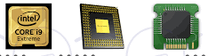
What is a Microprocessor?
Brain of computer/instrument.
Responsible for organizing and executing every instruction.
Following components:
CPU (Central processing unit)
Cache memory
Computer processor that incorporates the functions of a central processing unit
Miniature device

Slide 6
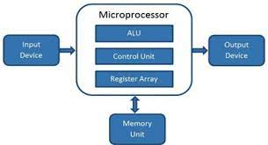
A microprocessor is programmable, multipurpose, clock-driven, register based electronic device that reads instructions from a storage device called memory, accepts data as input and processes data according to the instructions and then provides results as output.
A digital computer with one microprocessor which acts as a CPU is called Microcomputer.

Slide 7
Applications of Microprocessors in Medical Instrumentation
Microprocessors have replaced conventional electronic systems that were initially used for processing data.
This has resulted into a more reliable and faster data.
For digital control of all the functions in medical instrumentation systems.
Powerful microprocessors and large data storage capacities
Perform various functions: processing data, storing measurements, and analyzing results.
Optimize the measurement conditions.
Decision making capability
Numerous safety back-up features and real-time self-diagnostics and self-repair capabilities.
Automatic calibration, operator guidance, trend displays, alarm priority and automated record keeping.

Slide 8
Applications of Microprocessors in Medical Instrumentation
1. Patient Monitoring in Intensive Care Unit. 2. Pathological Analysis and the measurement of parameters like blood pressure and temperature. 3. Measurement of heart activity. 4. Ultrasound Processing unit. 5. MRI scanning (Magnetic resonance imaging) 6. CT scanning etc (Computerized tomography).

Slide 9
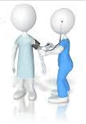
Why use of microprocessor in medical applications?
Greater accuracy than human
Lower running cost compared with human
24/7 monitoring patients
Monitoring of many different systems at once
Very rapid response
Continuous process
Monitor several patients at once
Reliable, small and light weight

Slide 10
PC Base Medical Instruments
Personal computer are popular in medical field and also software is largely commercially available
Computer are widely accepted in the medical field for data collection, manipulation, processing and a complete workstations for a variety of applications
A personal computer becomes a workstation with the simple installation of one or more ‘instruments-on-a-board’ in its accessory slots.

Slide 11
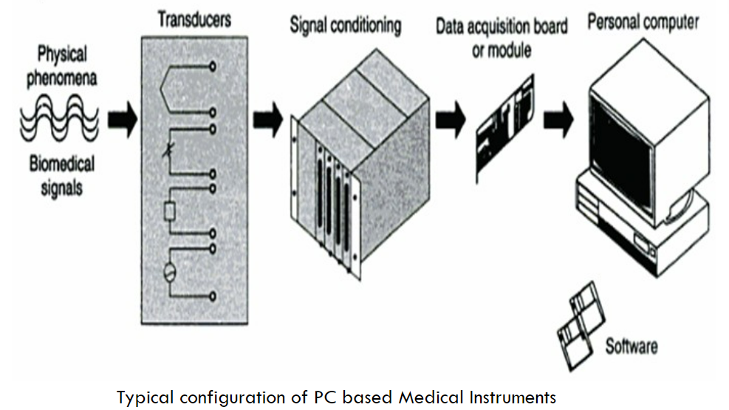

Slide 12
System is highly flexible and can accommodate a variety of inputs, which can be connected to PC for analysis, graphics and control
The systems works totally under the control of software
PC medical instruments are gaining in popularity for several reasons including price, programmability and performance specifications
Basic elements-
Biomedical signal
Sensor/transducers
Signal conditioning
Data acquisition/software package
Computer platform.

Slide 13
Microprocessors have been used to replace the complicated instructional procedures that are now required in some medical instruments.
Microprocessors based instrumentation has enabled the ability to make intelligent judgement and provide diagnostic signals/warnings in case of potential error or even take appropriate corrections!
This includes operating systems, devices drivers, libraries, languages and debugging tools

Slide 14
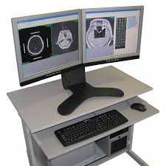
Advantages and applications of PC based medical instruments
Computer software can process X-rays, 3D models, and MRI scans to identify abnormalities.
Medical professionals then use this information to plan the best course of patient treatment.
In recent years, there has also been an increase in the use of wearable devices that collect data about a patient's health.

Slide 15
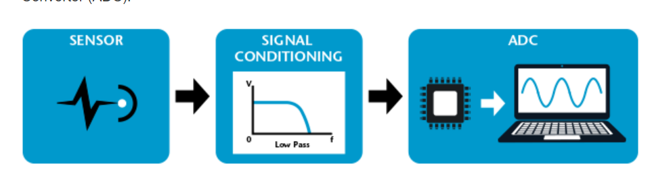
DATA ACQUISITION system
A data acquisition system is a collection of software and hardware that allows one to measure or control the physical characteristics of something in the real world.
These data acquisition systems will perform the tasks such as conversion of data, storage of data, transmission of data and processing of data.
Analog-to-Digital Converter
15

Slide 16
General constraints in design of Medical Instrumentation System
Medical equipment are primarily used for making measurements of physiological parameters of the human body and also in some cases as stimulus or some kind of energy is applied to the human body for diagnosis and treatment.
Important factors determined to design the system: Measurement range and frequency range.

Slide 17
General constraints in design of Medical Instrumentation System
The signal to be measured imposes constraints on how it should be acquired and processed
Many measurand in living systems are inaccessible
Placement of sensor(s) in/on the body plays a key role in medical instrumentation design
Magnitude and frequency range of medical measurand are very low
Interference and cross-talk artifacts (object made by human) (overlap of signals)
Proper sensor interface with measurand cannot be obtained
Medical variables are varying with time

Slide 18
REFERENCES
C. R. Balamurugan and D. Periazhaagar Basics of Biomedical Instrumentation. Magnus Publications, Chennai ISBN: 978-81-939626-7-1
Gupta, P.K.. Cytology, Genetics and Molecular Biology, Rastogi Publishers, Meerut, 1993.
Roit I.M., Brostoff J. and Male D. Mosby .Immunology (6 th Edition) by, An imprint of Elsevier Sci Ltd., 2002.
G. Webster , Medical Instrumentation: Application And Design, 3rd edition ,Wiley Publishers
D Reddy, Biomedical Signal Processing, Tata Mcgraw Hill Publications.
Sergio Cerutti Advanced Methods of Biomedical Signal Processing, Oxford Publications.
B. Jacobson, J.G. Webster, Medical and Clinical Engineering, Prentice Hall, International.
Cromwell, Biomedical Instrumentation and Measurements, Prentice Hall, International.
R.S. Khandupur, Handbook of Biomedical Instrumentation, - Tata McGraw Hill
Leslie Cromwell, Fred J. Weibell, Erich A. Pfeiffer, "Biomedical Instrumentation and Measurements", Pearson Education.
https://nptel.ac.in/courses/121/106/121106008/
https://www.utoledo.edu/engineering/bioengineering/undergrad/prospective/whatisbioe.html#:~:text=Bioengineering%20is%20the%20application%20of,health%20care%20and%20other%20fields
https://i.pinimg.com/originals/68/c9/30/68c930e95113ceb2e3dfc9de2f164680.png
https://youtu.be/FBUpnG1G4yQ

Slide 19
THANK YOU

